Slide 1
In Granite or Ingrained:
What the Old and New Covenants Reveal About the Gospel, the Law and the Sabbath
Skip MacCarty, D. Min
“The LORD Confides in those who fear him’ he makes his covenant known to them.” Ps 25:14

Slide 2
Why this study is important for Seventh-day Adventists
The Old and New Covenants

Slide 3
Abrahamic Covenant | Sinai Covenant “Old Covenant” | New Covenant
Promise/Faith Gen 15:6, 18 | Law/Obedience Deut 4:12-13 5:2-3 | Promise/Faith Grace/Love Holy Spirit Heb 8:7-9, 13
Evangelical Model of the Covenants
Especially the Old and New Covenants

Slide 4
God’s law/Covenant/Commandments are:
Perfect, holy, just, righteous, spiritual
Written in the heart
Ordained to life
Established by faith
Truth
Converts the soul
Liberty/freedom
Fulfilled in the life of Spirit-filled believers, kept by God’s saints
The power of sin
Written on stone
A letter that kills
Not based on faith
Veils the truth
A curse
Slavery/bondage
Must die to in order to have a relationship with Jesus

Slide 5
Abrahamic Covenant | Sinai Covenant | New Covenant
Promise/Faith Gen 15:6, 18 | Law/Obedience Deut 4:12-13 5:2-3 | Promise/Faith Grace/Love Holy Spirit Heb 8:7-9, 13
Galatians 1:6-9 One Gospel Hebrews 4:2 Same Gospel in OT and NT Revelation 14:6 Everlasting Gospel to all

Slide 6
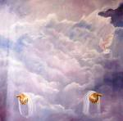
New Covenant DNA
Jer 31:31-34; Heb 8:10-12
I will write my laws in their minds/hearts
2. I will be their God; they will be my people
3. Everyone will know me; no one need teach people to know me
4. I will forgive their sins

Slide 7
New Covenant DNA
Jer 31:31-34; Heb 8:10-12
I will write my laws in their minds/hearts
Sanctification
2. I will be their God; they will be my people
Reconciliation
3. Everyone will know me; no one need teach people to know me
Revelation/Mission
4. I will forgive their sins
Justification
Gospel
Heb 4:2
Grace-based
Gospel-bearing
Mission-intended
Faith-inducing

Slide 8
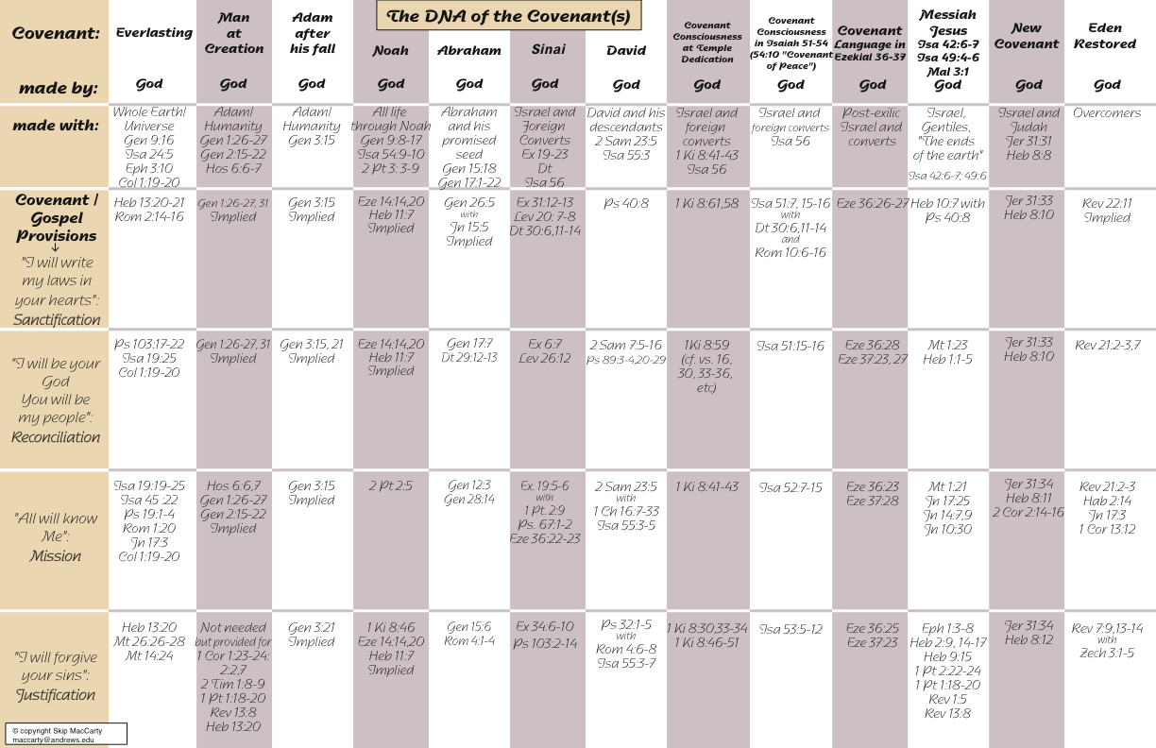

Slide 9
New Covenant DNA at Sinai
Jer 31:31-34; Heb 8:10-12
1. I will write my laws in their minds/hearts
Sanctification – Dt 30:6, 11-14/Rom 10:6-8; Deut 6:6; Ps 37:30-31; 40:8; Isa 51:7
2. I will be their God; they will be my people
Reconciliation – Lev 26:12
3. Everyone will know me; no one need teach people to know me
Revelation/Mission – Ex 19:5-6/Gen 28:14; Ps 67:1-2
4. I will forgive their sins
Justification– Ex 34:4-7
Gospel
Heb 4:2
Grace-based Ex 34:7
Gospel-bearing Heb 4:2
Mission-intended
Ex 19:5-6; Ps 67:1-2
Faith-inducing Mt 23:23

Slide 10
Abrahamic Covenant | Sinai Covenant “Old Covenant” | New Covenant
Promise/Faith Gen 15:6, 18 | Law/Obedience Deut 4:12-13 5:2-3 | Promise/Faith Grace/Love Holy Spirit Heb 8:7-9, 13
Evangelical Model of the Covenants
misrepresents the unity and coherence of the New Covenant throughout Scripture.
A replacement model is needed

Slide 11
The Everlasting Covenant
Eternal Life
Eternity Past

Slide 12
The Nature of God – The Essence of His Covenant
“⁹ Which of you, if your son asks for bread, will give him a stone? ¹⁰ Or if he asks for a fish, will give him a snake? ¹¹ If you, then, though you are evil, know how to give good gifts to your children, how much more will your Father in heaven give good gifts to those who ask him! ¹² So [Gk. oun, ‘therefore’] in everything, do to others what you would have them do to you, for this sums up the Law and the Prophets.” Matthew 7:9-12

Slide 13
The Everlasting Covenant
Eternal Life
Eternity Past
Creation

Slide 14
Human Condition at Creation
“²⁶ God said, ‘Let us make mankind in our image, in our likeness….’ ²⁸ God created mankind in his own image, in the image of God he created them…. ³¹ God saw all that he had made, and it was very good.” Gen 1:26-31

Slide 15
The Everlasting Covenant
Eternal Life
Eternity Past
Post-Fall Adam
Creation

Slide 16
Everlasting Covenant with Post-Fall Humanity
“¹⁴ So the Lord God said to the serpent, ‘Because you have done this…. ¹⁵ I will put enmity between you and the woman, and between your offspring and hers; he will crush your head, and you will strike his heel.’”
Gen 3:14-15

Slide 17
Post-Fall Human Condition
“¹⁰ As it is written: ‘There is no one righteous, not even one; ¹¹ there is no one who understands; there is no one who seeks God. ¹² All have turned away, they have together become worthless; there is no one who does good, not even one.’[Psalms 14:1-3; 53:1-3; Eccles. 7:20] ¹³ ‘Their throats are open graves; their tongues practice deceit.’ ^{[Psalm 5:9]} ‘The poison of vipers is on their lips.’ ^{[Psalm 140:3]} ¹⁴‘Their mouths are full of cursing and bitterness.’ ^{[Psalm 10:7]} ¹⁵ ‘Their feet are swift to shed blood; ¹⁶ ruin and misery mark their ways, ¹⁷ and the way of peace they do not know.’^{[Isa 59:7-8] 18} ‘There is no fear of God before their eyes.’ ^{[Ps 36:1]}” Rom 3:10-18

Slide 18
Post-Fall Human Condition
¹⁹Now we know that whatever the law says, it says to those who are under the law, so that every mouth may be silenced and the whole world held accountable to God.” Rom 3:19

Slide 19
Everlasting Covenant Broken Whole World Guilty
“⁴ The earth dries up and withers, the world languishes and withers, the heavens languish with the earth. ⁵ The earth is defiled by its people; they have disobeyed the laws, violated the statutes and broken the everlasting covenant.” Isaiah 24:4-5
“Now we know that whatever the law says, it says to those who are under the law, so that every mouth may be silenced and the whole world held accountable to God.” Rom 3:19

Slide 20
Everlasting Covenant Commitment
“²⁰ But where sin abounded. . .grace abounded much more, ²¹ so that as sin reigned in death, even so grace might reign through righteousness to eternal life through Jesus Christ our Lord.” Rom 5:20-21 NKJV

Slide 21
Everlasting Covenant Commitment
“²⁰ But where sin abounded, grace abounded. . . much more, ²¹ so that as sin reigned in death, even so grace might reign through righteousness to eternal life through Jesus Christ our Lord.” Rom 5:20-21 NKJV

Slide 22
Everlasting Covenant Commitment
“²⁰ But where sin abounded, grace abounded much more. . . ²¹ so that as sin reigned in death, even so grace might reign through righteousness to eternal life through Jesus Christ our Lord.” Rom 5:20-21 NKJV

Slide 23
Everlasting Covenant Commitment
“²⁰ But where sin abounded, grace abounded much more, ²¹ so that as sin reigned in death, even so grace might reign through righteousness to eternal life through Jesus Christ our Lord.” Rom 5:20-21 NKJV

Slide 24
Everlasting Covenant Commitment
“⁸…the gospel…. ⁹ He has saved us and called us to a holy life—not because of anything we have done but because of his own purpose and grace. This grace was given us in Christ Jesus before the beginning of time.”
2 Tim 1:8-10

Slide 25
The Everlasting Covenant
Covenant of Grace
God’s Universal Gift to Humanity
(Everlasting Gospel Bridge from Paradise Lost to Paradise Restored)
Eternal Life
Eternity Past
Post-Fall Adam
Creation

Slide 26
The Everlasting Covenant
Covenant of Grace
God’s Universal Gift to Humanity
(Everlasting Gospel Bridge from Paradise Lost to Paradise Restored)
Eternal Life
Eternity Past
Noah
Post-Fall Adam
Creation

Slide 27
Covenant with Noah “Established”
“¹⁸ I will establish my covenant with you, and you will enter the ark—you and your sons and your wife and your sons’ wives with you.” Gen 6:18

Slide 28
Covenant with Noah “Established”
“¹⁸ I will establish my covenant with you, and you will enter the ark—you and your sons and your wife and your sons’ wives with you.” Gen 6:18
“The first explicit scriptural reference to God’s making a covenant appears in Genesis 6:18: ‘With thee [Noah] will I establish my covenant; and thou shalt come into the ark….’ The typical expression for the making of a covenant does not appear in this passage, namely, the one employed in eighty Old Testament instances—‘to cut a covenant,’ or in the typical and appropriate idiomatic expression in English, ‘to make a covenant.’ Here the term used is to establish (heqim) [‘to maintain/confirm’].
Hasel and Hasel, The Promise, 28-29

Slide 29
Covenant with Noah “Established”
“¹⁸ I will establish my covenant with you, and you will enter the ark—you and your sons and your wife and your sons’ wives with you.” Gen 6:18
“Even though Genesis 6:18 is the earliest reference to a covenant in the Bible, the use of this particular Hebrew term [heqim,‘to establish/maintain/confirm’] in connection with it implies that God had previously made a covenant with humanity. In this sense, the covenant of God with Noah may be seen as a renewal of His covenant with Adam, to which the Bible points implicitly in Genesis 3:15.”
Hasel and Hasel, The Promise, 28-29

Slide 30
Everlasting Covenant with Post-Flood Humanity
“¹⁴ Whenever I bring clouds over the earth and the rainbow appears in the clouds, ¹⁵ I will remember my covenant between me and you and all living creatures of every kind. Never again will the waters become a flood to destroy all life. ¹⁶ Whenever the rainbow appears in the clouds, I will see it and remember the everlasting covenant between God and all living creatures of every kind on the earth.” Gen 9:14-16

Slide 31
The Everlasting Covenant
Covenant of Grace
God’s Universal Gift to Humanity
(Everlasting Gospel Bridge from Paradise Lost to Paradise Restored)
Eternal Life
Eternity Past
Abraham
Noah
Post-Fall Adam
Creation

Slide 32
Abrahamic Covenant
“¹⁸ On that day the LORD made a covenant with Abram and said, “To your descendants I give this land….” Genesis 15:18
“¹⁰ This is my covenant with you and your descendants after you, the covenant you are to keep: Every male among you shall be circumcised…. ¹⁹ Sarah will bear you a son, and you will call him Isaac. I will establish my covenant with him as an everlasting covenant for his descendants after him.” Genesis 17:10, 19

Slide 33
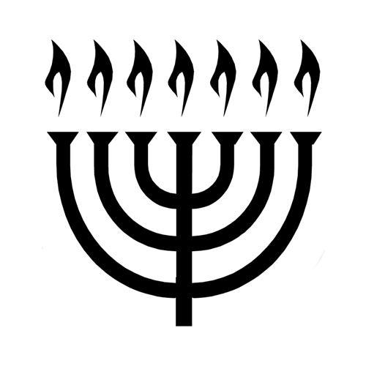
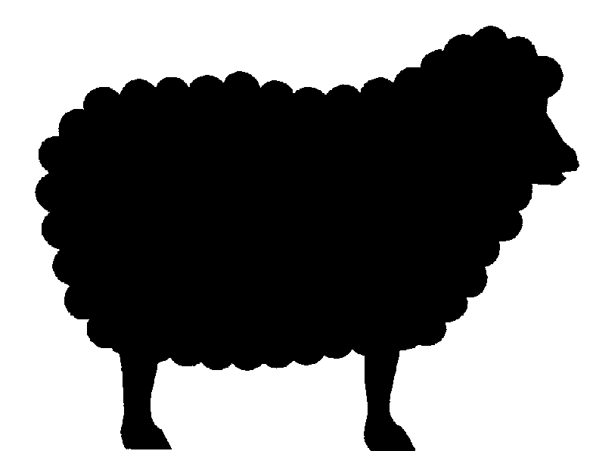
The Everlasting Covenant
Covenant of Grace
God’s Universal Gift to Humanity
(Everlasting Gospel Bridge from Paradise Lost to Paradise Restored)
Eternal Life
Eternity Past
Gospel In Symbols
Israel
Abraham
Noah
Post-Fall Adam
Creation

Slide 34
Mosaic/Sinai Covenant
“¹² Then the LORD spoke to you out of the fire. You heard the sound of words but saw no form; there was only a voice. ¹³ He declared to you his covenant, the Ten Commandments, which he commanded you to follow and then wrote them on two stone tablets.” Deuteronomy 4:12-13

Slide 35
Sinai Covenant Linked with Adam
“⁴ What shall I do with you, O Ephraim? What shall I do with you, O Judah? For your loyalty is like a morning cloud And like the dew which goes away early…. ⁷ But like Adam they have transgressed the covenant; There they have dealt treacherously against Me.”
Hosea 6:4-7 NASB

Slide 36
One Progressively Developing and Revealed Covenant of Grace
“⁷ He is the Lord our God; his judgments are in all the earth. ⁸ He remembers his covenant forever, the promise he made, for a thousand generations, ⁹ the covenant he made with Abraham, the oath he swore to Isaac. ¹⁰ He confirmed it to Jacob as a decree, to Israel as an everlasting covenant.” Psalm 105:7-10

Slide 37
Everlasting Covenant of Grace Universally Broken
“⁴ The earth dries up and withers, the world languishes and withers, the heavens languish with the earth. ⁵ The earth is defiled by its people; they have disobeyed the laws, violated the statutes and broken the everlasting covenant.” Isaiah 24:4-5

Slide 38
Law and Grace at Sinai
“Moreover the law entered that the offense might abound. But where sin abounded, grace abounded much more.” Rom 5:20-21 NKJV

Slide 39
The Sinai-Covenant Gospel of Grace
“⁷ He made known his ways to Moses, his deeds to the people of Israel: ⁸ The Lord is compassionate and gracious, slow to anger, abounding in love. ⁹ He will not always accuse, nor will he harbor his anger forever; ¹⁰ he does not treat us as our sins deserve or repay us according to our iniquities. ¹¹ For as high as the heavens are above the earth, so great is his love for those who fear him; ¹² as far as the east is from the west, so far has he removed our transgressions from us. Ps 103:7-18

Slide 40
The Sinai-Covenant Gospel of Grace
“¹³ As a father has compassion on his children, so the Lord has compassion on those who fear him; ¹⁴ for he knows how we are formed, he remembers that we are dust…. ¹⁷ From everlasting to everlasting the Lord’s love is with those who fear him, and his righteousness with their children’s children— ¹⁸ with those who keep his covenant and remember to obey his precepts.”
Ps 103:7-18

Slide 41
When the Sinai-Covenant Gospel of Grace Began
“This grace was given us in Christ Jesus before the beginning of time.” 1 Tim 1:8-10

Slide 42
The Everlasting Covenant
Covenant of Grace
God’s Universal Gift to Humanity
(Everlasting Gospel Bridge from Paradise Lost to Paradise Restored)
Eternal Life
Eternity Past
Gospel In Symbols
Israel
David
Abraham
Noah
Post-Fall Adam
Creation

Slide 43
Covenant with David
“The inspired utterance of David son of Jesse, the utterance of the man exalted by the Most High, the man anointed by the God of Jacob, the hero of Israel’s songs:… ⁵ If my house were not right with God, surely he would not have made with me an everlasting covenant, arranged and secured in every part; surely he would not bring to fruition my salvation and grant me my every desire.” 2 Sam 23:1, 5

Slide 44
The Everlasting Covenant
Covenant of Grace
God’s Universal Gift to Humanity
(Everlasting Gospel Bridge from Paradise Lost to Paradise Restored)
Eternal Life
Eternity Past
Gospel In Symbols
JESUS
Israel
David
Abraham
Noah
Post-Fall Adam
Creation

Slide 45
Jesus—the Covenant Personified
“⁶ I, the Lord, have called You in righteousness, and will hold Your hand; I will keep You and give You as a covenant to the people, as a light to the Gentiles, ⁷ To open blind eyes, To bring out prisoners from the prison, those who sit in darkness from the prison house.” Isaiah 42:6-7 NKJV

Slide 46
Jesus— Confirmed the Covenant
“He will confirm a covenant with many for one ‘seven’[NIV footnote, ‘week’]. In the middle of the ‘seven’[NIV fn., ‘week’] he will put an end to sacrifice and offering.” Daniel 9:27

Slide 47
Jesus— Confirmed the Covenant
“He will confirm a covenant with many for one ‘seven’[NIV footnote, ‘week’]. In the middle of the ‘seven’[NIV fn., ‘week’] he will put an end to sacrifice and offering.” Daniel 9:27
When Jesus came to earth, what covenant did He “confirm?”

Slide 48
Jesus— Confirmed the Covenant
“He will confirm a covenant with many for one ‘seven’[NIV footnote, ‘week’]. In the middle of the ‘seven’[NIV fn., ‘week’] he will put an end to sacrifice and offering.” Daniel 9:27
When Jesus came to earth, what covenant did He “confirm?”
How did Jesus confirm the Everlasting Covenant / Covenant of Grace?

Slide 49
Jesus— Confirmed the Covenant
“He will confirm a covenant with many for one ‘seven’[NIV footnote, ‘week’]. In the middle of the ‘seven’[NIV fn., ‘week’] he will put an end to sacrifice and offering.” Daniel 9:27
When Jesus came to earth, what covenant did He “confirm?”
How did Jesus confirm the Everlasting Covenant / Covenant of Grace?
How did Jesus “put an end to sacrifice and offering?”

Slide 50
The Blood of the Everlasting Covenant
“²⁰ Now may the God of peace, who through the blood of the eternal covenant brought back from the dead our Lord Jesus, that great Shepherd of the sheep, ²¹ equip you with everything good for doing his will, and may he work in us what is pleasing to him, through Jesus Christ, to whom be glory for ever and ever. Amen.” Heb 13:19-20
“[Jesus] took bread, gave thanks and broke it, and gave it to them, saying, ‘This is my body given for you; do this in remembrance of me.’ ²⁰ In the same way, after the supper he took the cup, saying, ‘This cup is the new covenant in my blood, which is poured out for you.’” Luke 22:19-22

Slide 51
The Everlasting Covenant
Covenant of Grace
God’s Universal Gift to Humanity
(Everlasting Gospel Bridge from Paradise Lost to Paradise Restored)
Eternal Life
Eternity Past
Gospel In Symbols
JESUS
Israel
David
Abraham
Noah
Post-Fall Adam
Creation

Slide 52
The Cross and the Covenant
Desire of Ages, 176
“The light shining from the cross reveals the love of God. His love is drawing us to Himself. If we do not resist this drawing, we shall be led to the foot of the cross in repentance for the sins that have crucified the Saviour. Then the Spirit of God through faith produces a new life in the soul. The thoughts and desires are brought into obedience to the will of Christ. The heart, the mind, are created anew in the image of Him who works in us to subdue all things to Himself. Then the law of God is written in the mind and heart, and we can say with Christ, ‘I delight to do Thy will, O my God.’ Ps. 40:8.”

Slide 53
Blood of the Covenant Reconciles All Things
“For God was pleased to have all his fullness dwell in him, and through him to reconcile to himself all things, whether things on earth or things in heaven, by making peace through his blood, shed on the cross.” Col 1:19-20

Slide 54
A New Covenant
“¹⁵ For this reason Christ is the mediator of a new covenant, that those who are called may receive the promised eternal inheritance—now that he has died as a ransom to set them free from the sins committed under the first covenant.” Heb 9:15

Slide 55
A New Covenant
“¹⁵ For this reason Christ is the mediator of a new covenant, that those who are called may receive the promised eternal inheritance—now that he has died as a ransom to set them free from the sins committed under the first covenant.” Heb 9:15
“⁹ This grace was given us in Christ Jesus before the beginning of time, ¹⁰ but it has now been revealed through the appearing of our Savior, Christ Jesus, who has destroyed death and has brought life and immortality to light through the gospel.” 1 Tim 1:9-10

Slide 56
The Everlasting Covenant
Covenant of Grace
God’s Universal Gift to Humanity
(Everlasting Gospel Bridge from Paradise Lost to Paradise Restored)
Eternal Life
Eternity Past
God’s Historical Old Covenant
(Everlasting Gospel - OT Era)
Gospel In Symbols
God’s Historical New Covenant
(Everlasting Gospel - NT Era)
JESUS
Israel
David
Abraham
Noah
Post-Fall Adam
Creation

Slide 57
Abrahamic Covenant | Sinai Covenant “Old Covenant” | New Covenant
Promise/Faith Gen 15:6, 18 | Law/Obedience Deut 4:12-13 5:2-3 | Promise/Faith Grace/Love Holy Spirit Heb 8:7-9, 13

Slide 58
Abrahamic Covenant | Sinai Covenant “Old Covenant” | New Covenant
Promise/Faith Gen 15:6, 18 | Law/Obedience Deut 4:12-13 5:2-3 | Promise/Faith Grace/Love Holy Spirit Heb 8:7-9, 13
Evangelical Model of the Covenants
misrepresents the unity and coherence of the New Covenant throughout Scripture.
A replacement model is needed

Slide 59
The Everlasting Covenant
Covenant of Grace
God’s Universal Gift to Humanity
(Everlasting Gospel Bridge from Paradise Lost to Paradise Restored)
Eternal Life
Eternity Past
New Covenant DNA
God’s Historical Old Covenant
(Everlasting Gospel - OT Era)
Gospel In Symbols
New Covenant DNA
God’s Historical New Covenant
(Everlasting Gospel - NT Era)
JESUS
Israel
David
Abraham
Noah
Post-Fall Adam
Creation

Slide 60
Abrahamic Covenant | Sinai Covenant “Old Covenant” | New Covenant
Promise/Faith Gen 15:6, 18 | Law/Obedience Deut 4:12-13 5:2-3 | Promise/Faith Grace/Love Holy Spirit Heb 8:7-9, 13
Galatians 1:6-9 One Gospel Hebrews 4:2 Same Gospel in OT and NT Revelation 14:6 Everlasting Gospel to all
New Covenant DNA
New Covenant DNA
New Covenant DNA

Slide 61
God’s law/Covenant/Commandments are:
Perfect, holy, just, righteous, spiritual
Written in the heart
Ordained to life
Established by faith
Truth
Converts the soul
Liberty/freedom
Fulfilled in the life of Spirit-filled believers, kept by God’s saints
The power of sin
Written on stone
A letter that kills
Not based on faith
Veils the truth
A curse
Slavery/bondage
Must die to in order to have a relationship with Jesus

Slide 62
The Everlasting Covenant
Covenant of Grace
God’s Universal Gift to Humanity
(Everlasting Gospel Bridge from Paradise Lost to Paradise Restored)
Eternal Life
Eternity Past
New Covenant DNA
God’s Historical Old Covenant
(Everlasting Gospel - OT Era)
Gospel In Symbols
New Covenant DNA
God’s Historical New Covenant
(Everlasting Gospel - NT Era)
JESUS
Israel
David
Abraham
Noah
Humanity’s Response to God’s Gift (faith or disbelief)
Post-Fall Adam
Creation
Sinful-Nature-Generated Old Covenant Experience –
Gospel Perverted and Externalized
Holy-Spirit-Generated New Covenant Experience –
Gospel Accepted and Internalized

Slide 63
The Everlasting Covenant
Covenant of Grace
God’s Universal Gift to Humanity
(Everlasting Gospel Bridge from Paradise Lost to Paradise Restored)
Eternal Life
Eternity Past
New Covenant DNA
Above the line
Historical Orientation
God’s Historical Old Covenant
(Everlasting Gospel - OT Era)
Gospel In Symbols
New Covenant DNA
God’s Historical New Covenant
(Everlasting Gospel - NT Era)
JESUS
Israel
David
Abraham
Noah
Humanity’s Response to God’s Gift (faith or disbelief)
Post-Fall Adam
Below the line
Experiential Orientation
Creation
Sinful-Nature-Generated Old Covenant Experience –
Gospel Perverted and Externalized
Holy-Spirit-Generated New Covenant Experience –
Gospel Accepted and Internalized

Slide 64
How the Covenants Differed God anticipated a different response
“For if there had been nothing wrong with that first covenant, no place would have been sought for another. ⁸ But God found fault with the people and said: ‘The days are coming, declares the Lord, when I will make a new covenant with the people of Israel and with the people of Judah. ⁹ It will not be like the covenant I made with their ancestors when I took them by the hand to lead them out of Egypt, because they did not remain faithful to my covenant, and I turned away from them, declares the Lord.’”
Heb 8:7-9

Slide 65
How the Covenants Differed God anticipated a different response
“For if there had been nothing wrong with that first covenant, no place would have been sought for another. ⁸ But God found fault with the people and said: ‘The days are coming, declares the Lord, when I will make a new covenant with the people of Israel and with the people of Judah. ⁹ It will not be like the covenant I made with their ancestors when I took them by the hand to lead them out of Egypt, because they did not remain faithful to my covenant, and I turned away from them, declares the Lord.’”
Heb 8:7-9

Slide 66
The Everlasting Covenant
Covenant of Grace
God’s Universal Gift to Humanity
(Everlasting Gospel Bridge from Paradise Lost to Paradise Restored)
Eternal Life
Eternity Past
New Covenant DNA
Above the line
Historical Orientation
God’s Historical Old Covenant
(Everlasting Gospel - OT Era)
Gospel In Symbols
New Covenant DNA
God’s Historical New Covenant
(Everlasting Gospel - NT Era)
JESUS
Israel
David
Abraham
Noah
Humanity’s Response to God’s Gift (faith or disbelief)
Post-Fall Adam
Below the line
Experiential Orientation
Below the line
Experiential Orientation
Creation
Sinful-Nature-Generated Old Covenant Experience –
Gospel Perverted and Externalized
“They did not remain faithful”
Holy-Spirit-Generated New Covenant Experience –
Gospel Accepted and Internalized
Different response anticipated
(Hebrews 8:7-9)

